Slide 1
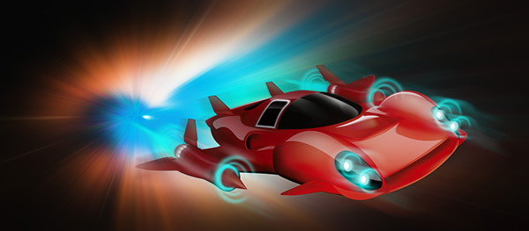
Need for Lightspeed

Slide 2
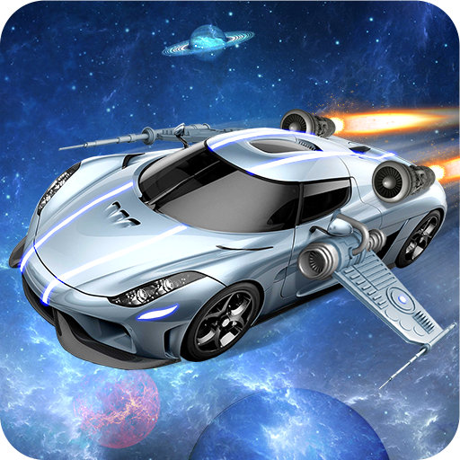
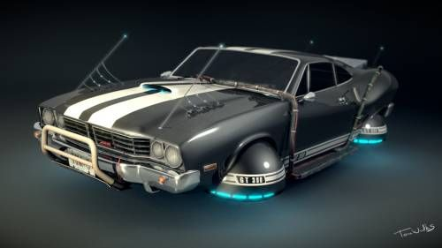
Elevator Pitch
Take Need for Speed, add rocket boosters instead of nitrus and lightspeed jump booster rings to other planets instead of checkpoints.

